Slide 1


University Ranking analysis

Slide 2

Problem Definition
Global university rankings impact education choices, funding, and employability. This analysis explores:
Datasets Used
Datasets Used:
1- Shanghai Ranking 2024 (Research-Focused)
World Rank, Alumni & Faculty Awards (Nobel, Fields Medal).
Publications & Citations (Research impact).
2- Times Higher Education (THE) 2024 (Balanced Approach)
World Rank, Teaching & Research Scores.
Citations, Industry Income & International Outlook.
3- Word Rank University (CWUR) 2024 (Employability & Trends)
World & National Rank, Quality of Education.
Alumni Employment, Research Output, Faculty Quality.
Top-ranked universities & key performance factors.
Employability rankings & job market relevance.
Saudi universities' global position.
Influence of research, faculty, and gender diversity on rankings.

Slide 3
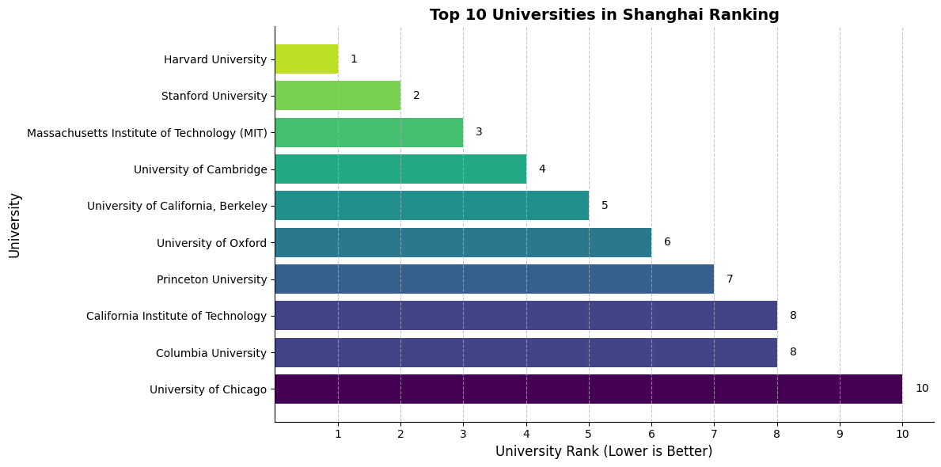
Top 10 Universities Globally
Key Insights:
Harvard, Stanford, and MIT dominate across all rankings.
Universities from the US and UK consistently perform well.

Slide 4
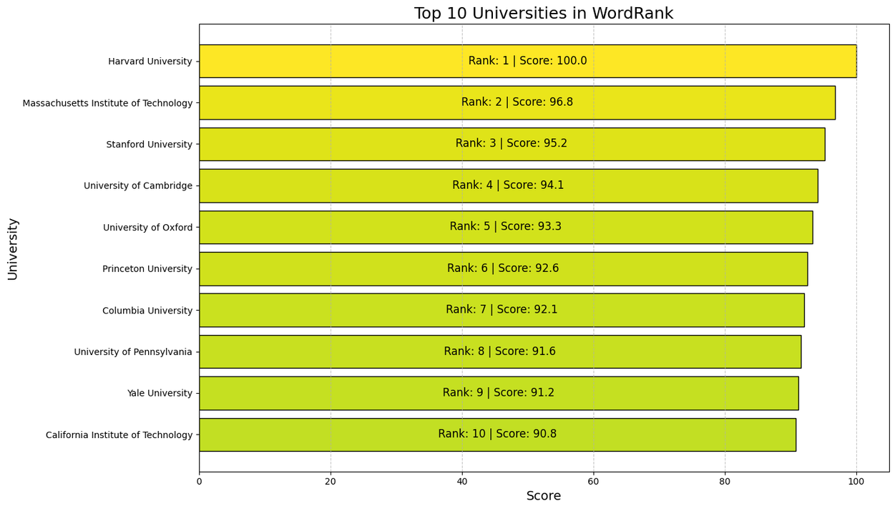
Top 10 Universities Globally
Key Insights:
Harvard, Stanford, and MIT dominate across all rankings.
Universities from the US and UK consistently perform well.

Slide 5
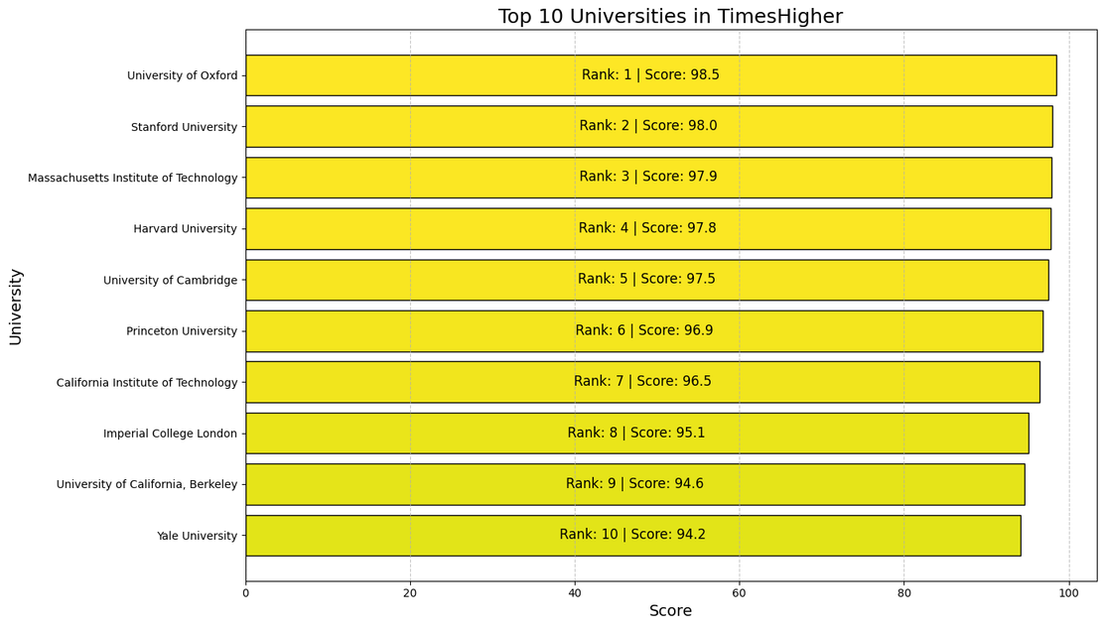
Top 10 Universities Globally
Key Insights:
Harvard, Stanford, and MIT dominate across all rankings.
Universities from the US and UK consistently perform well.

Slide 6
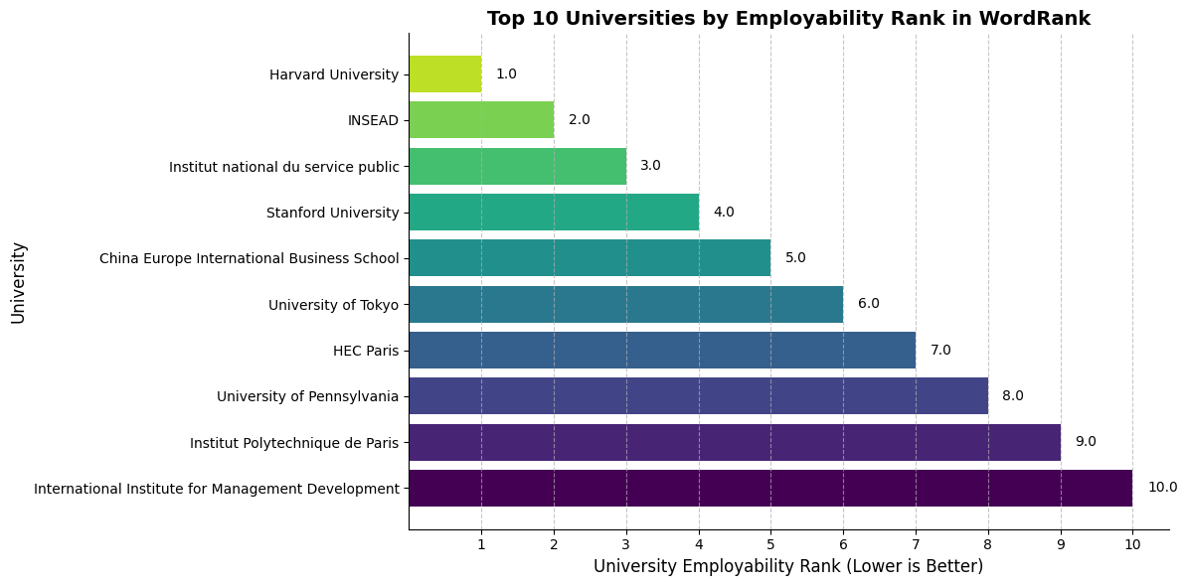
Top 10 Universities for Employment Outcomes
Key Insights:
Harvard is ranked #1 for employment outcomes.
Graduates from these universities have high employer demand.

Slide 7
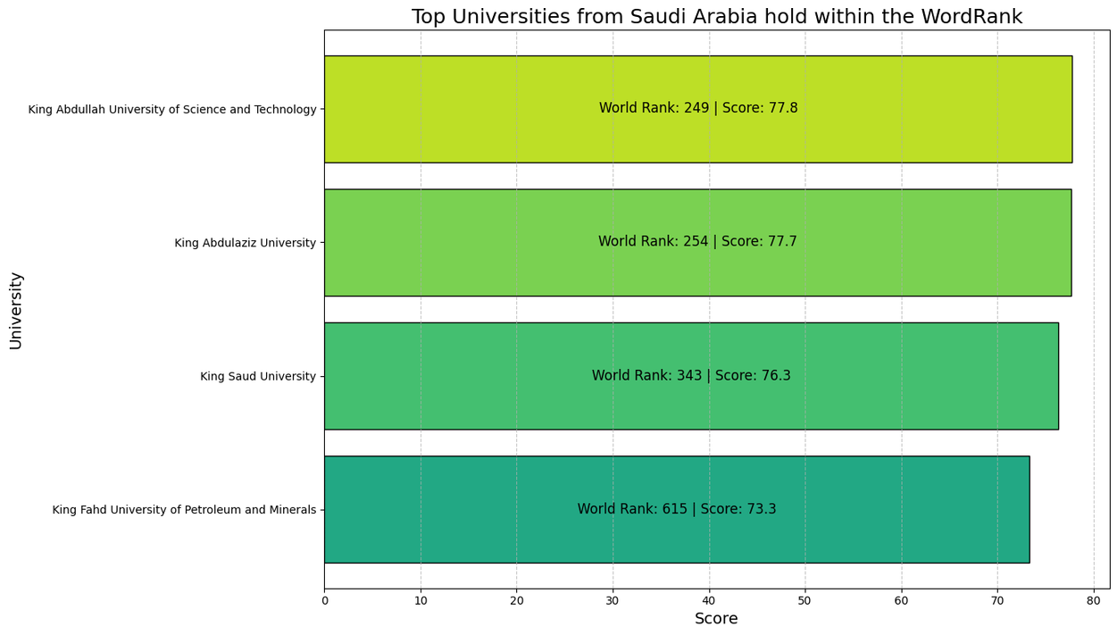
Saudi Universities in Global Rankings
Key Insights:
King Abdullah University of Science and Technology (#249)
King Abdulaziz University (#254)
King Saud University (#343)
King Fahd University of Petroleum and Minerals (#615)

Slide 8
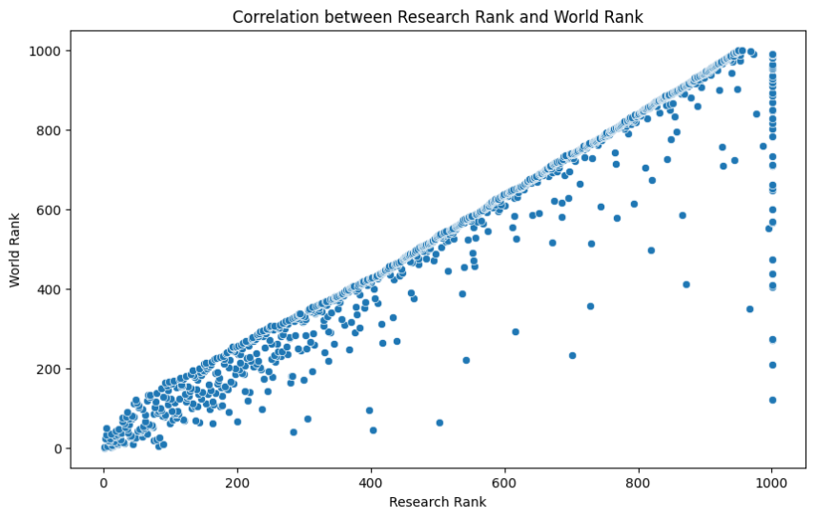
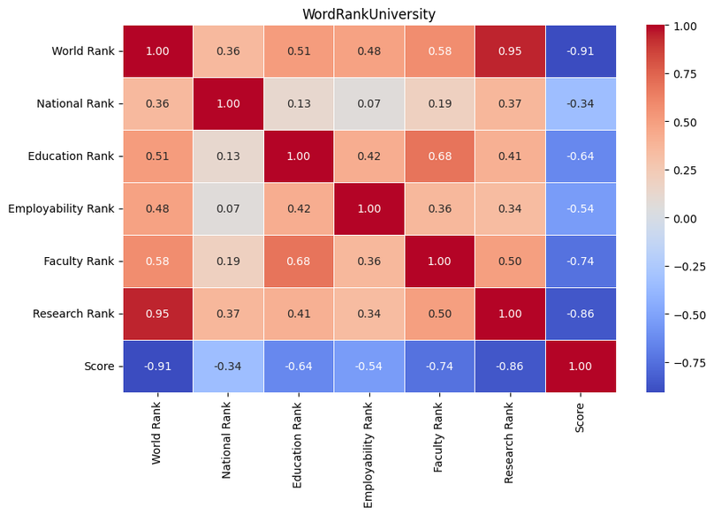
What Factors Influence University Rankings?
Key Insights:
Research Rank strongly correlates with overall ranking.
Faculty expertise & employability reputation are significant factors.
Funding & citation impact drive top-tier rankings.

Slide 9
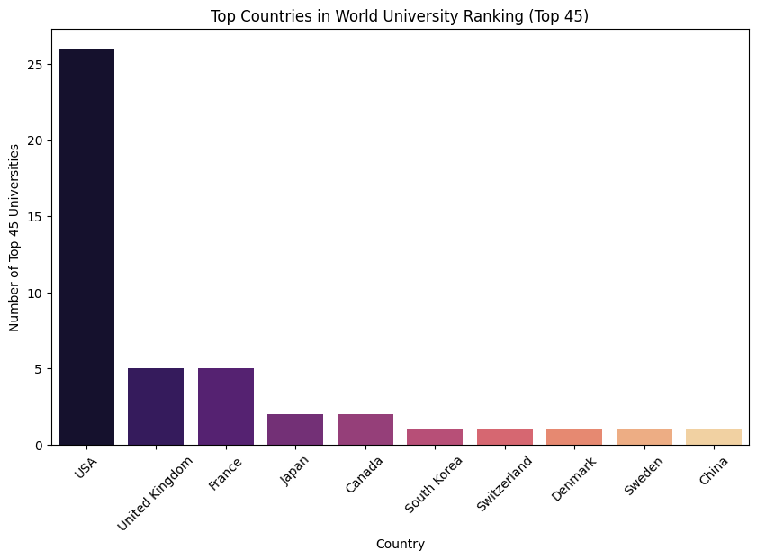
Which Countries Have the Most Top-Ranked Universities?
Key Insights:
The U.S. dominates (25+ universities in the Top 45).
The UK & France also have strong representation.

Slide 10
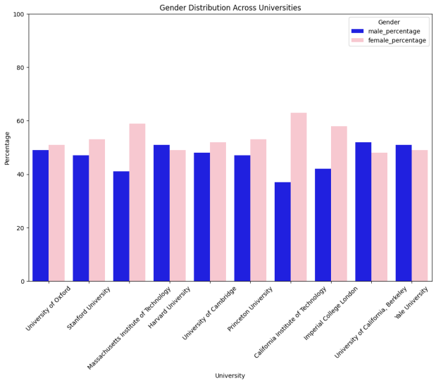
Gender Distribution Across Universities
Key Insights:
Displays male & female student percentages across 10 top-ranked universities.
Some universities have a strong male dominance (e.g., Caltech).
Others show a more balanced ratio (e.g., Harvard, Yale).

Slide 11


Q&A and Discussion
Fell Free to Ask!

